Slide 1


PROJECT ReWind
ReWind time to pre-COVID with Augmented Reality.
TEAM SQUADRA
HARSHITA SHANKHDHAR,
ISHITA SHARMA,
ADITI MITTAL
HackOFiesta-Flagship Hackathon of India
01

Slide 2
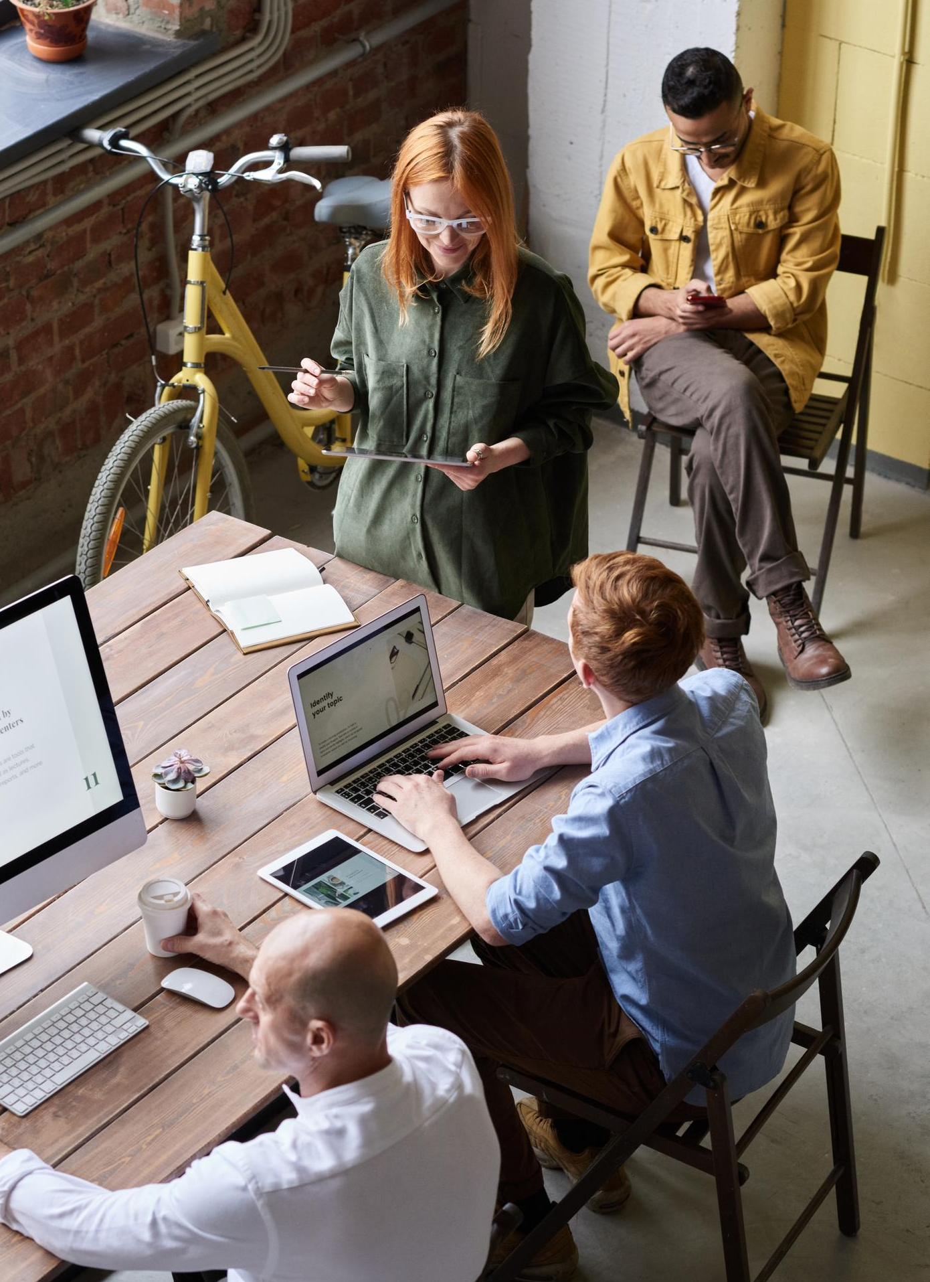

PROBLEM STATEMENT
ReWind is a website based application which gives the user a platform to relive the life they are living before COVID 19 pandemic happened. In the current situation , people are forced to avoid meeting with their loved ones, not only that it has affected their routines like shopping, attending weddings, classes ,etc. This is where the need of this project ReWind comes in. This website application has everything a customer wants when going to organize a function(since only limited people are allowed) or attending classes or buying home decor.

Slide 3

PROPOSED SOLUTION
=>Organizing your functions by creating an AR for the guests who are not able to make it to your special day.
=>Reliving your memories by uploading them on our website and viewing it with a 3D experience.
=>Ditching normal online classes and learning things with AR experience.
=>If you are a teacher upload your video and we will make it an extraordinary video with AR.
=>Want to visualize how your art piece will look on the wall before buying it , with our project you can easily do that .
=>Easy payment option with 2 free demos .

Slide 4

4.Relive pre-covid times
UNIQUE SELLING POINTS
1.Helps you relive your memories
This project brings you an inch closer to pre-covid times by using Augmented Reality which basically helps you to visualize everything in 3-Dimension.
This project of ours gives you the chance of reliving your memories. Experience your fond moments in 3-D by our Augmented Reality feature.
5.Easy Login Feature
2.Makes education fun
Our website provides you with a secured authentication process by providing an easy and safe login/signup feature to access the website.
Understand concepts better by visualizing and understanding them by watching videos/content uploaded by your teachers with a twist of “3-Dimension”.
6.Secure Payment option
3.Design your room
A secure payment option is available in our website using Razor pay .
With ReWind, we give you an option to see how a picture/painting/decor you desire to add to your room will look in 3-dimension with our Augmented Reality before you make a purchase.

Slide 5

YOUR TECH STACK
1.
FRONTEND
For the frontend part of our project we have made use of HTML, CSS, Bootstrap.
2.
BACKEND
The backend of our project has been made using JavaScript, Firebase, Firestore and EchoAR.
3.
PAYMENT AND HOSTING
We have made use of RazorPay API for our payment method and the hosting of the project has been done on Google Chrome.

Slide 6
THANK YOU

